Slide 1
News You Need to Know from the Mailers Technical Advisory Committee
July 17, 2019
Presented by: Cathy Rupard, Mark Fallon

Slide 2
MTAC – Overview
MTAC Overview
Welcome
What is MTAC
PCC AC role
Session contributors
Cathy Rupard
Dina Kessler
Neal Fedderman
Mark Fallon

Slide 3
MTAC Open Session

Slide 4
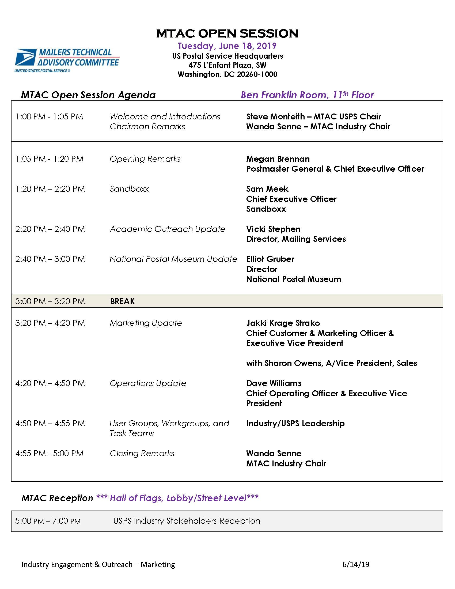
MTAC Open Session
Held Tuesday before MTAC meetings
Everyone can attend
June 18, 2019 Agenda
Notes:
MTAC Open Session
Held Tuesday before MTAC meetings
Everyone can attend
Typical Agenda

Slide 5
MTAC – Open Session
June 18, 2019 Open Session Highlights
Postmaster General
Mail Volume is down approximately 1.5% to SPLY.
Senate Committee on Homeland Security and Governmental Affairs has approved 3 nominees, however no floor vote yet.
PMG optimistic about legislation in the House.
Ten-year plan will be released “in due time.” There’s a $125 billion gap in the next 10 years.

Slide 6
MTAC – Open Session
June 18, 2019 Open Session Highlights
Sam Meek, CEO of Sandboxx
Sandboxx connects recruits in Boot Camp to family and friends.
The Sandboxx app converts digital messages, including photos, into physical mail that is delivered directly to the military bases.
Also includes a pre-addressed envelope and stationery for reply.
MTAC attendees were allowed to send a free message to a basic trainee.

Slide 7
MTAC – Open Session
June 18, 2019 Open Session Highlights
Vicki Stephen, Academic Outreach
At NPF, 15 courses at 25 colleges
For Fall 2019, 48 courses at 30 colleges (and growing)
Wilkes-Barre, PA “Direct Effect Innovation Challenge”
More at PostalPro

Slide 8
MTAC – Open Session
June 18, 2019 Open Session Highlights
Elliott Gruber, Director National Postal Museum
2025 will be 250th anniversary of the USPS
Museum is exploring an innovative way to celebrate.
Remodel of museum – what would we do if opening today?

Slide 9
MTAC – Open Session
June 18, 2019 Open Session Highlights
Marketing and Sales Update, Jakki Strako & Sharon Owens
Informed Delivery has over 17 million subscribers
Sharon discussed the Sales reporting structure and operating model
Chief Operating Officer, Dave Williams
AGV – Automated Guided Vehicles. $1 billion investment with goal to reduce associated labor by 40%
Still testing Next Generation Delivery Vehicles – testing complete, now analytics
“Middle Mile Vehicles” – driverless test went well. Early phase of the project.

Slide 10
MTAC Membership Assembly

Slide 11
MTAC – Membership Assembly
Chief Information Security Officer, Greg Crabb
Reviewing Informed Delivery Campaigns for malware, etc.
Ramping up for increased number of campaigns with Informed Delivery promotion this fall.
Concerns about standards for Informed Delivery Campaigns (appearance, interaction, etc.) – potential workgroup?
Department of Transportation, Joanna Luu & Robert Starin
HAZMAT – PHMSA.
Form F800.1 – Undeclared HAZMAT incident reporting.
https://checkthebox.dot.gov/

Slide 12
MTAC – Membership Assembly
Global Business Vice President and Managing Director, Giselle Valera
Universal Postal Union (UPU) update.
Potential date for withdrawal – October 17, 2019.
UPU Extraordinary Congress: September 24-25, 2019 in Geneva, Switzerland to vote on 3 Options for Terminal Dues
Option B – Self Declared Rates for Small Packages
USPS is seeking to establish agreements with foreign posts to continue exchanging mail if the US withdraws from the UPU
USPS will also use commercial logistics partners for foreign deliveries
Rate request (under seal) filed with the PRC

Slide 13
MTAC Focus Group Sessions

Slide 14
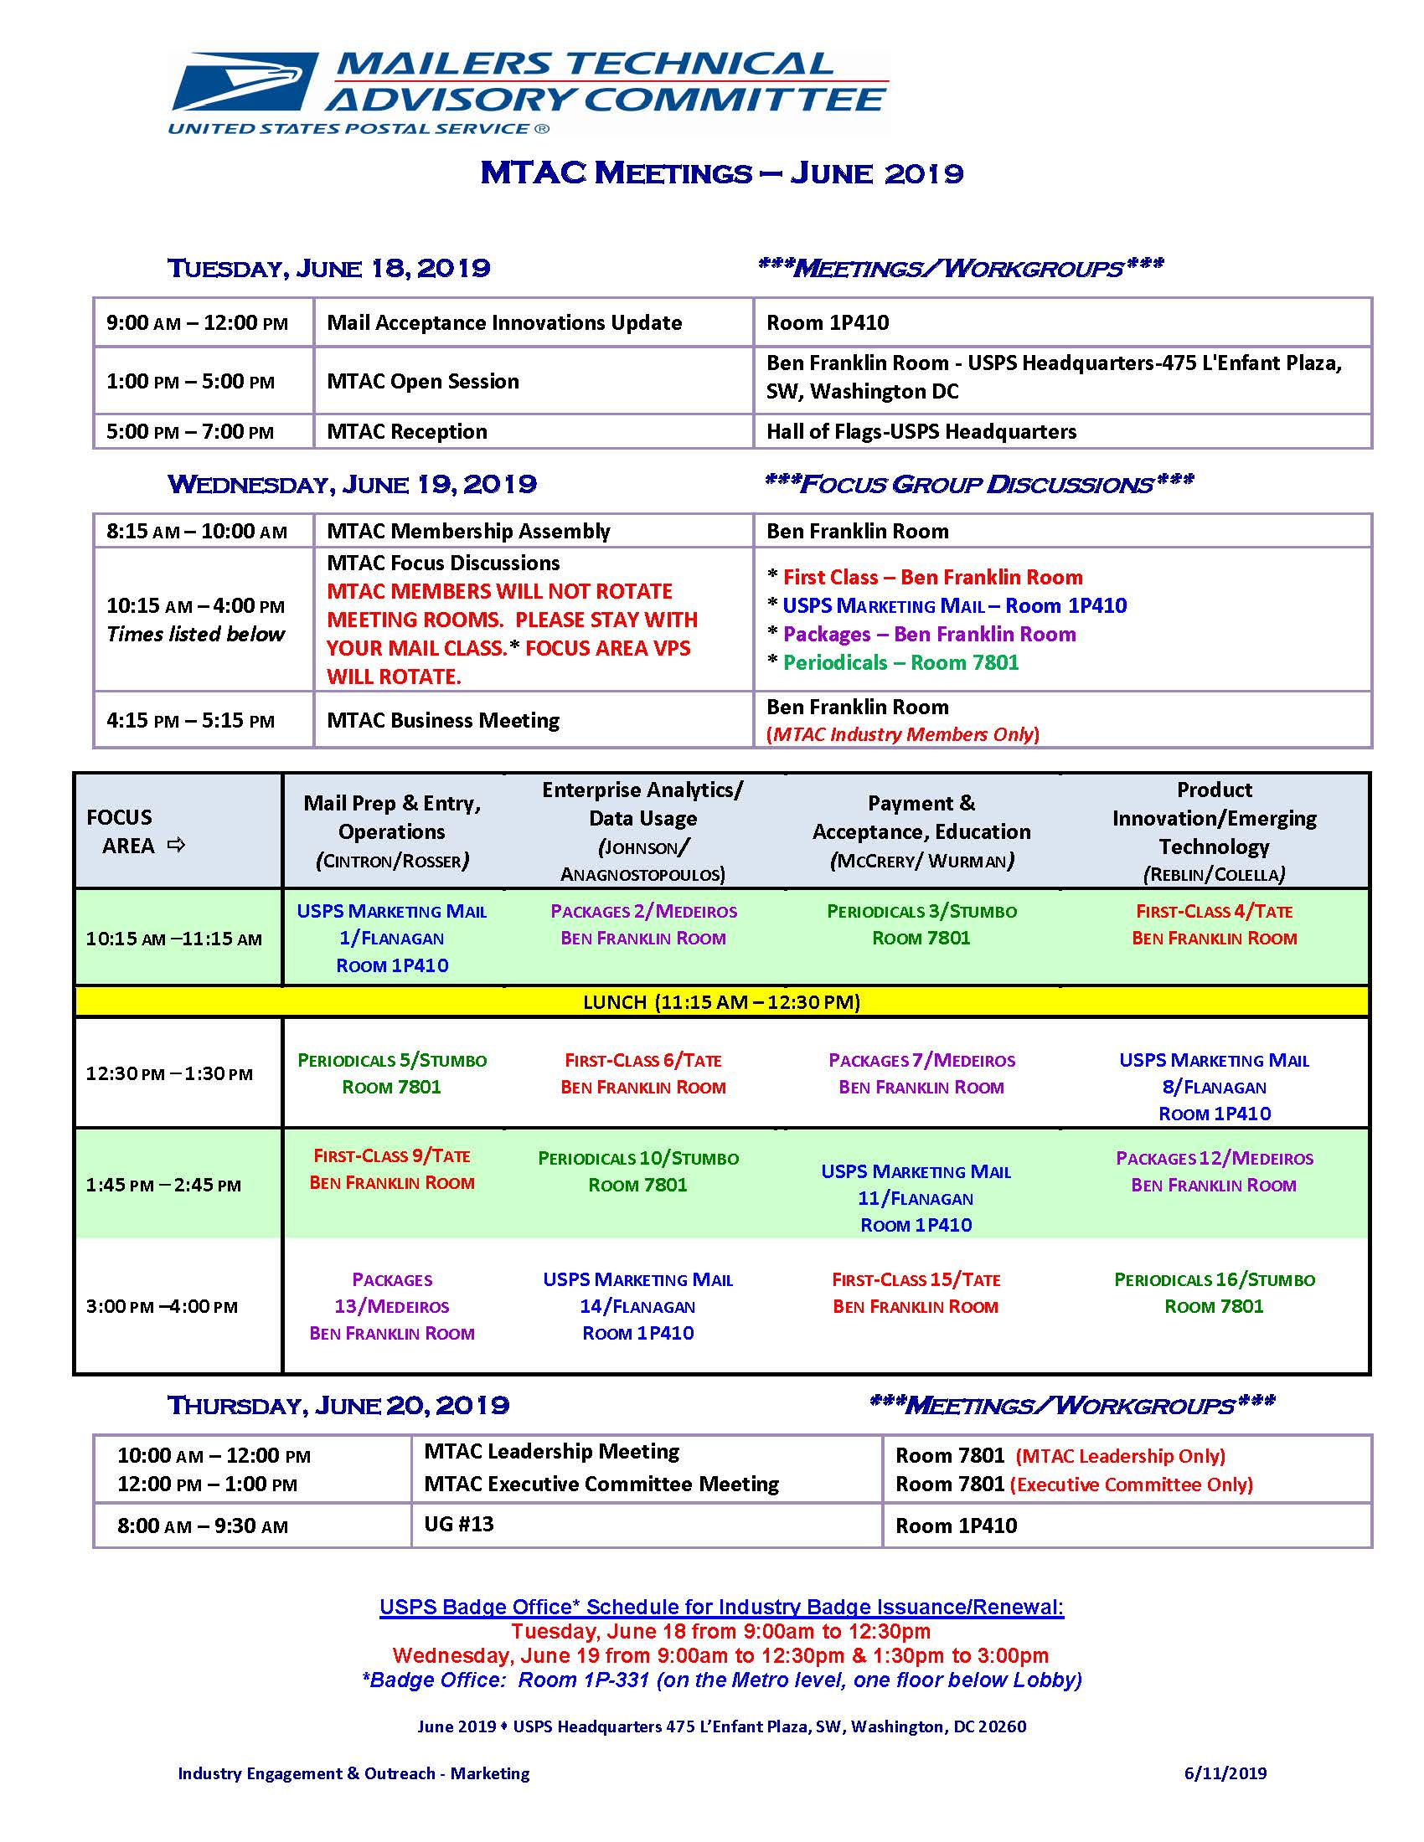
MTAC Focus Group
Held on Wednesday
Mail Prep & Entry
Enterprise Analytics
Payment & Acceptance
Product Innovation
Break out by classes
Rotating briefings
June 19, 2019 Agenda
Notes:
MTAC Open Session
Held Tuesday before MTAC meetings
Everyone can attend
Typical Agenda

Slide 15
Mail Prep and Entry, Operations

Slide 16
Mail Prep and Entry –
Operations
Update
Service Performance Metrics
Visibility / Scanning
UAA Mail
FAST / Drop Shipments
Passive Adaptive Scanning System (Packages)
Presentations available on PostalPro!

Slide 17
Mail Prep and Entry –
Operations
Service Performance
First-Class Mail – overnight 96.4, 2-day 95.3, 3-5 day 93.6
Marketing Mail – Destination letters 95.3/flats 92.7 Originating letters 68.7 /flats 56.8
Periodicals – DSCF 89.6, DADC 90.2, DNDC 86.6
Visibility - Scans
Marketing Mail – low pallet scans (~89%)
Periodicals - ~93% containers scans

Slide 18
Mail Prep and Entry –
Operations
UAA Mail – Top 5 Reasons
Not deliverable as addressed/unable to forward/FOE – 31.74%
Change of Address – 30.45%
Not known – 13.28%
Insufficient address – 6.00%
Vacant – 4.82%
UAA Mail – by Class
First-Class Mail – 58.24%
USPS Marketing Mail – 33.19%
Periodicals – 8.41%

Slide 19
Mail Prep and Entry –
Operations
Fast Appointments
Past 4 weeks – 29.2% of appointments no shows – increased from last quarter
Potential to use GPS to update status of inbound vehicles

Slide 20
Mail Prep and Entry –
Operations
Passive Adaptive Scanning System
Mobile cart with overhead camera to scan and packages
Future functionality
Capture mailpiece attributes (weight and dimensions)
Identify data/manifest issues
Revenue assurance

Slide 21
Enterprise Analytics

Slide 22
Enterprise Analytics
CASS/MASS
Cycle O – August 2021
New DPS algorithm resolving 11-digit conflicts
COA promotions – driving more records into system
New digital format for Move Validation Letter – savings on processing costs

Slide 23
Enterprise Analytics
UAA
UAA for Marketing Mail has declined, while FCM has increased
Mailers that get charged for ACS update records more frequently than those that receive free ACS
Need for further data analysis

Slide 24
Enterprise Analytics
Informed Visibility
Physical scan of mailpiece is proof of induction – potential change to Certificate of Mailing requirements (establish workgroup)
Can Mailer-IV, with GPS, be used to replace FAST appointments? Need to investigate
ZIP Code association concerns (handhelds vs. manifest)

Slide 25
Product Innovation Emerging Tech

Slide 26
Product Innovation
& Emerging Technology

Slide 27
Product Innovation
& Emerging Technology
Informed Delivery
Promotion requirements are on PostalPro
17.2 million users
Issues with no images on Monday
System memory issue
Update planned for July
Privacy Laws
Mailers must work with their own legal departments
Industry alert – July 2, 2019

Slide 28
Payment & Acceptance Education

Slide 29
Payment & Acceptance Education
Enterprise Payment System
All migrations, including exceptions must be completed by July 1, 2019
85% of eligible permits migrated (as of 6/19/19)
No target date to close CAPS

Slide 30
Payment & Acceptance Education
Business Customer Gateway
BCG Redesign (Phase I) – new interface and style
BCG Widgets
EPS
Mailer Scorecard
Recent mailings via PostalOne! Dashboard
Enhanced Account Management
Enable BSAs to remove users from CRIDS
Automate helpdesk tasks
General fixes

Slide 31
Payment & Acceptance Education
Mailing & Shipping Solutions Center (MSSC)
Nationwide launch on April 26, 2019
Software to track issues, including ticket numbers for tracking
Single phone number: 877-672-0007 (7:00am – 7:00pm CT)
96% satisfaction score

Slide 32
Payment & Acceptance Education
Seamless Acceptance
Federal Register Notice (September 2019):
Parallel by March 1, 2020
Complete by September 1, 2020
Retire manual verification by February 2021
Seamless Focus Group created
Satisfaction on migrating to Seamless Acceptance remains high

Slide 33
Payment & Acceptance Education
DIM Weight Changes - Packages
New calculated DIM weight formula – June 23, 2019
Concerns over potential manifest errors (new scenarios)
May require additional programming by vendors
USPS will monitor and flag issues during implementation

Slide 34
Questions?

Slide 35
MTAC
Closing Comments
Additional Information
For additional information on topics please go to PostalPro.
Find the MTAC tab.
Look for MTAC June 2019 meeting notes and presentations.
Next MTAC Meeting – August 27-28, 2019.
Note: Tuesday, August 27 is open to the public, email: MTAC@usps.gov
Any issues you would like to see addressed?

Slide 36
Thank You!
For Joining Us

